Slide 1
Customer Life Time Value Analysis
Team Name: Black Clover
Roshan Upadhyay – RA2011047010015
Priyansh Srivastava – RA2011047010022

Slide 2
Table of Contents
1
2
3
4
Abstract
Background
Marketing Analytics Concepts Used
Marketing Analytics Tools Used
5
Application Areas

Slide 3
1
Abstract

Slide 4
The aim of the project is to determine the value a customer brings to a business over the course of their relationship.
This project involves analyzing customer behavior, purchase patterns, and customer demographics to develop a comprehensive understanding of customer behavior and the financial impact of retaining customers over time.

Slide 5
2
Background

Slide 6
CLV analysis calculates the expected financial value of a customer over the course of their relationship with a business, including future purchases and potential referrals.
CLV is used to evaluate the profitability of acquiring and retaining customers and to measure the effectiveness of marketing and sales strategies.
By understanding the value of each customer, businesses can allocate resources more effectively, prioritize customer acquisition and retention efforts, and improve customer satisfaction.

Slide 7
3
Marketing Analytics Concepts Used

Slide 8
RFM (Recency, Frequency, Monetary) Analysis
Recency: The number of days since each customer's last purchase, using the most recent purchase date in the dataset as a reference point.
Frequency: The total number of purchases made by each customer in the dataset.
Monetary: The total amount of money spent by each customer in the dataset.
Clustering of customers based on RFM Analysis

Slide 9
4
Marketing Analytics Tools Used

Slide 10





Slide 11
5
Code & Ouput

Slide 12
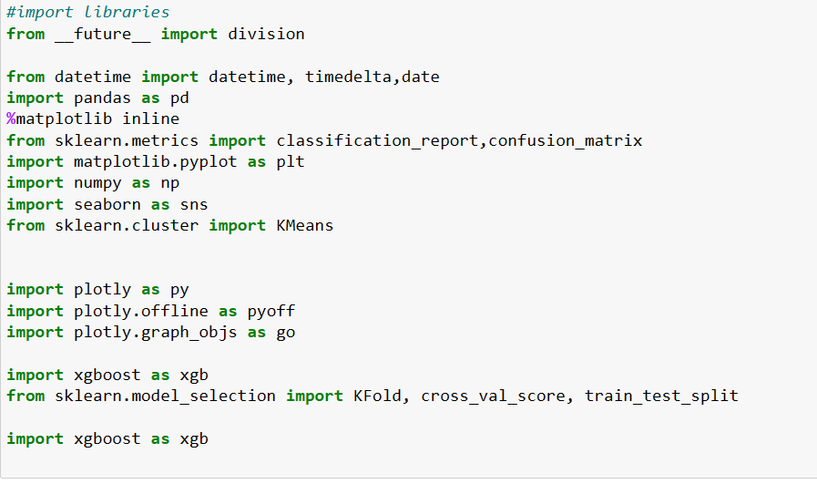

Slide 13
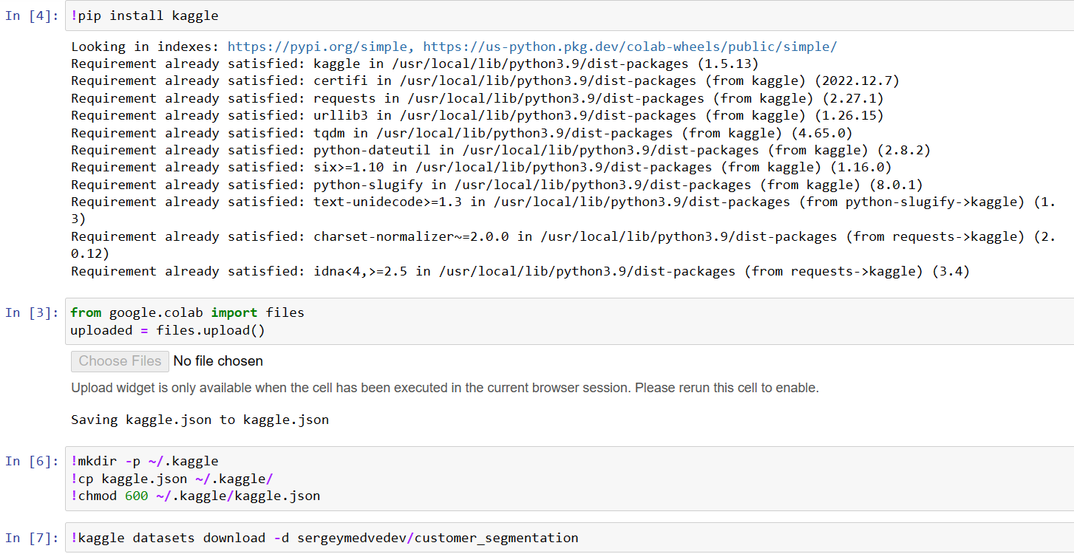

Slide 14
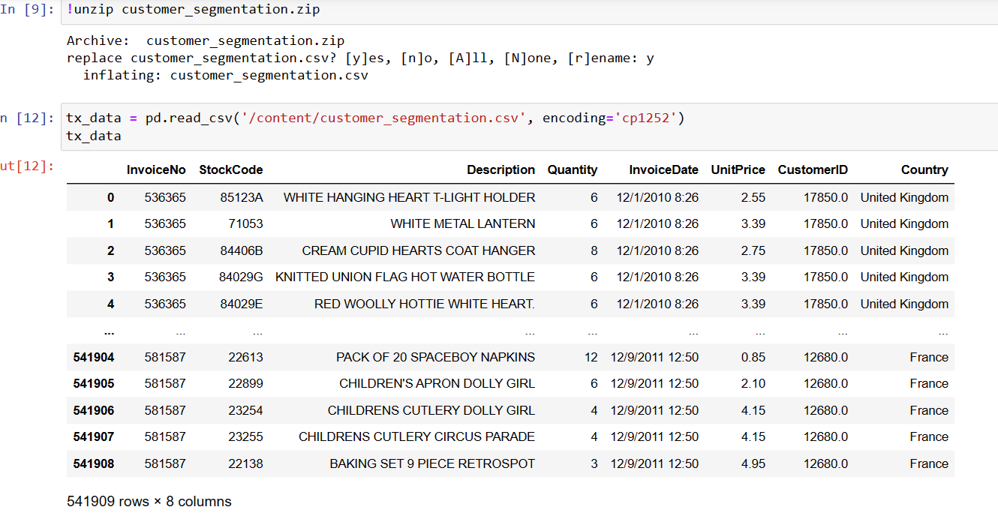

Slide 15
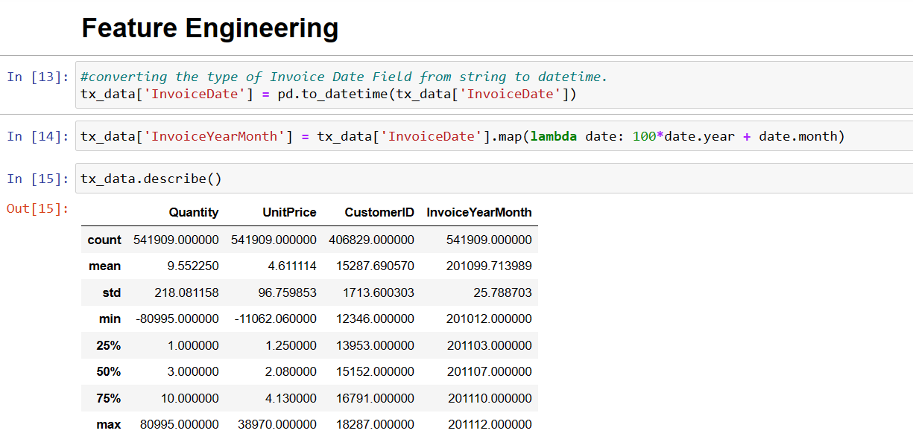

Slide 16
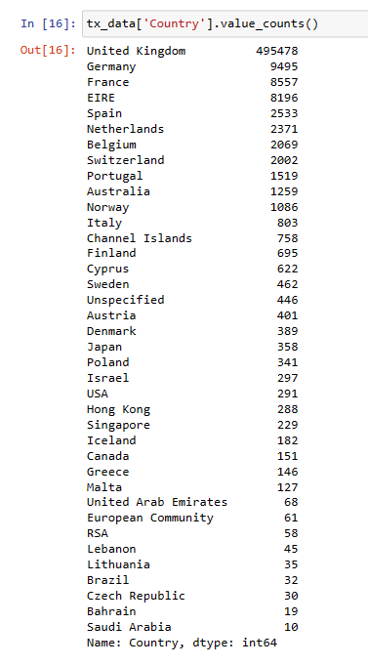

Slide 17
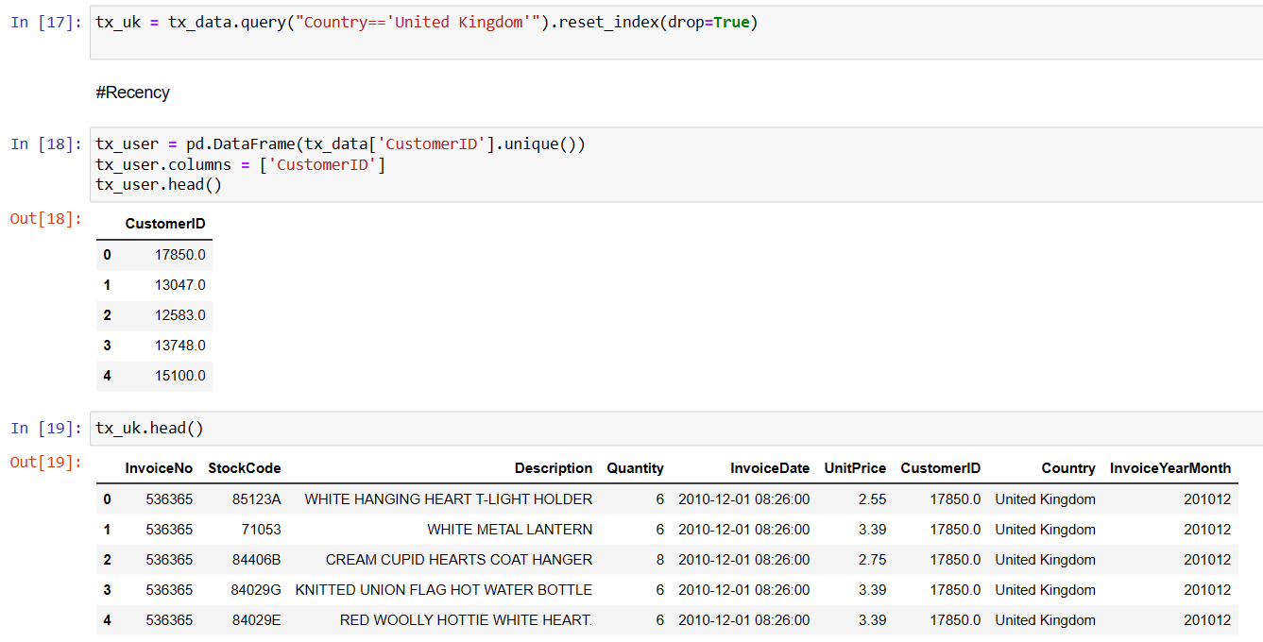

Slide 18
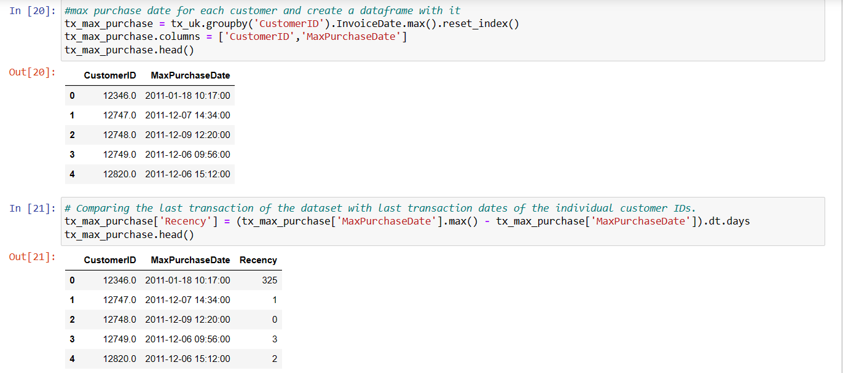

Slide 19
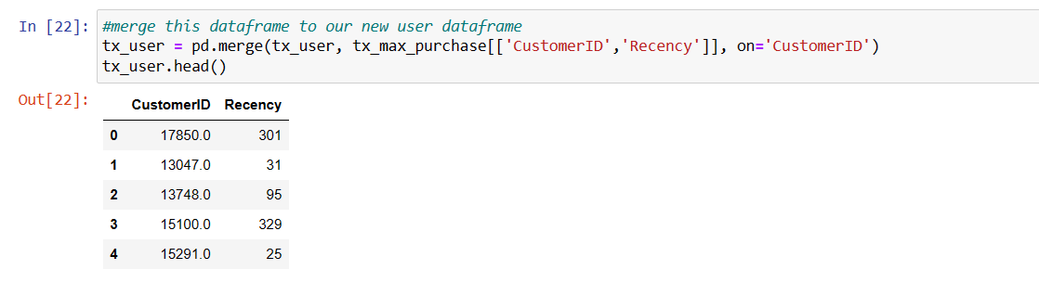

Slide 20
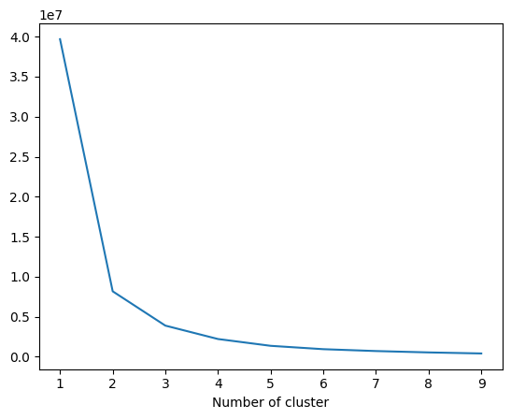

Slide 21
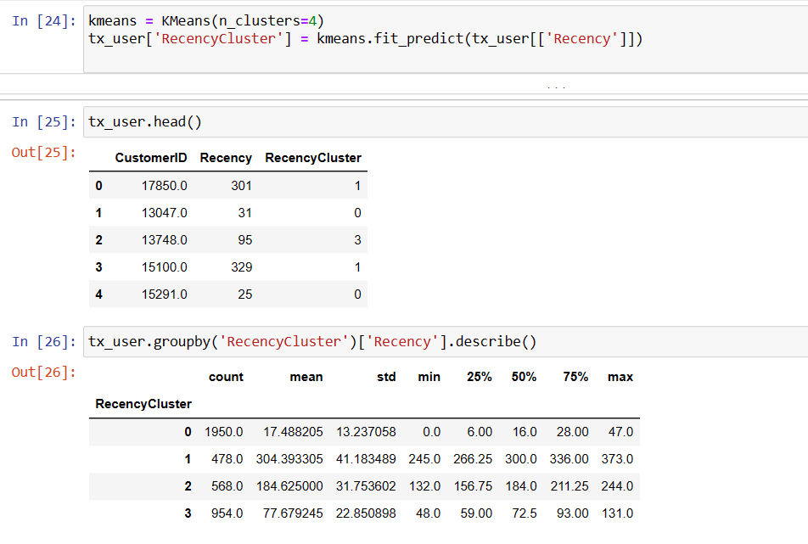

Slide 23
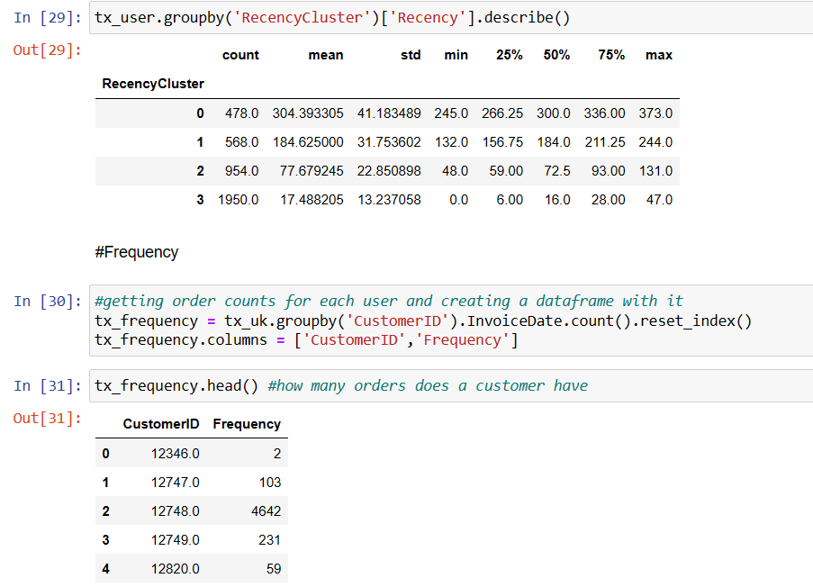

Slide 24
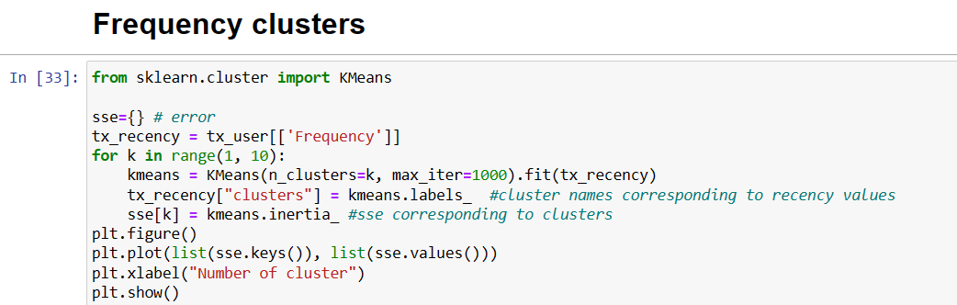

Slide 25
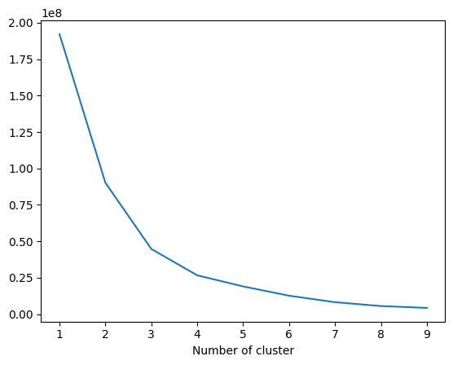

Slide 26
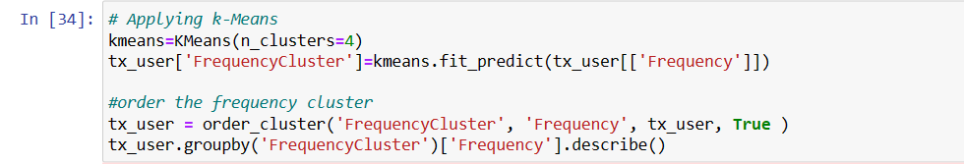
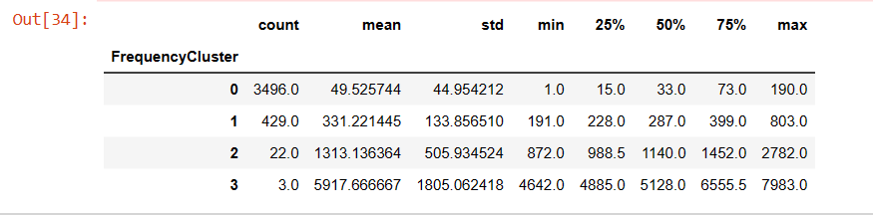

Slide 27
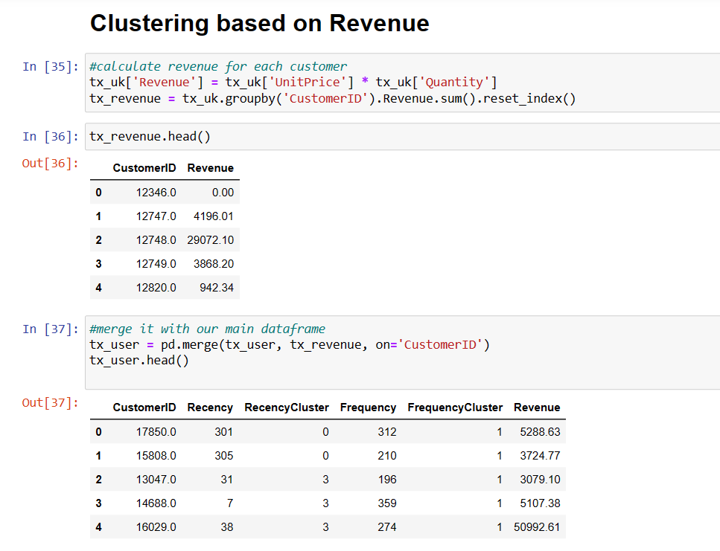

Slide 28
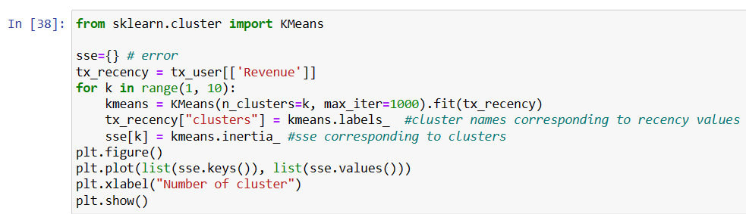

Slide 29
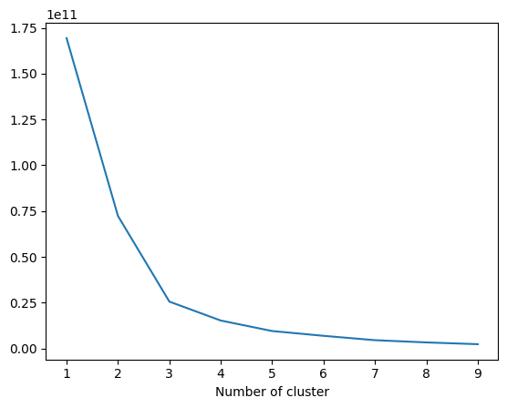

Slide 30
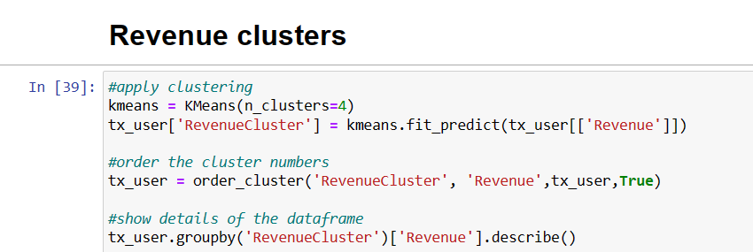
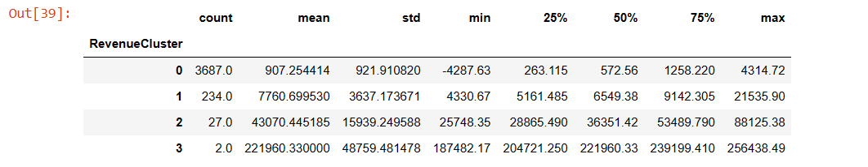

Slide 31
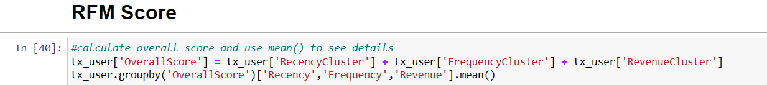
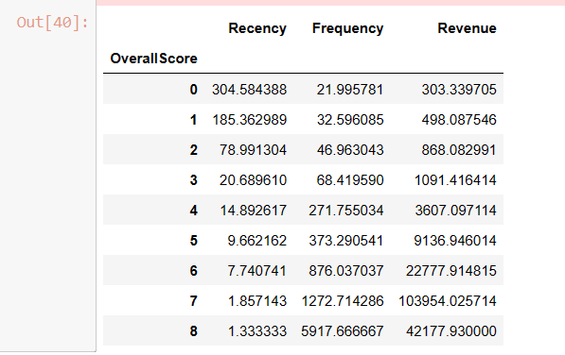

Slide 32
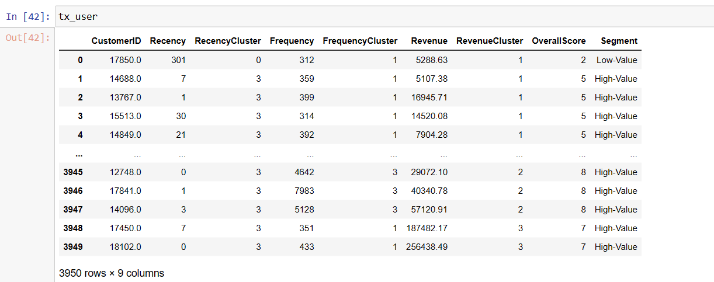
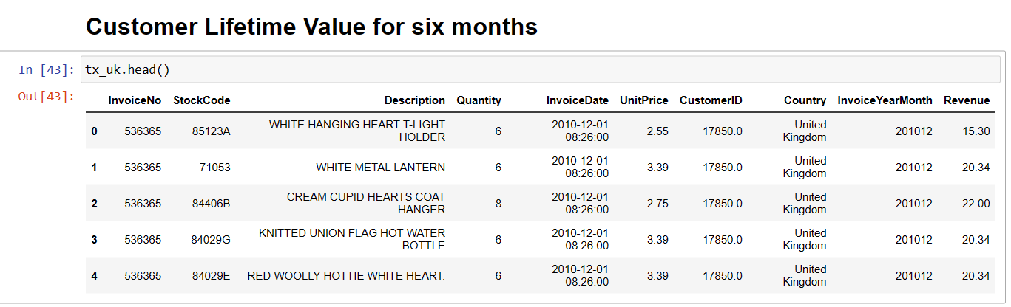

Slide 33
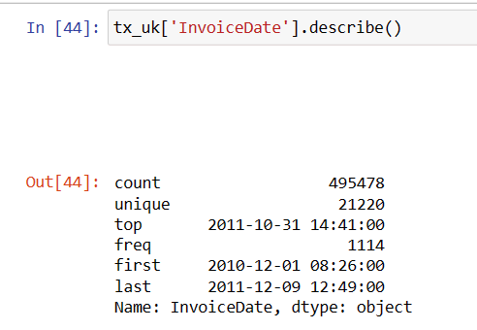
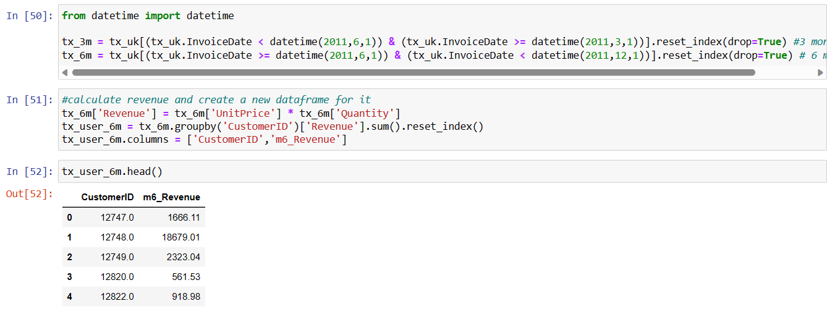

Slide 34
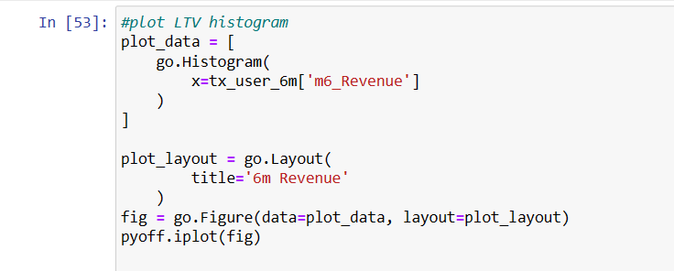
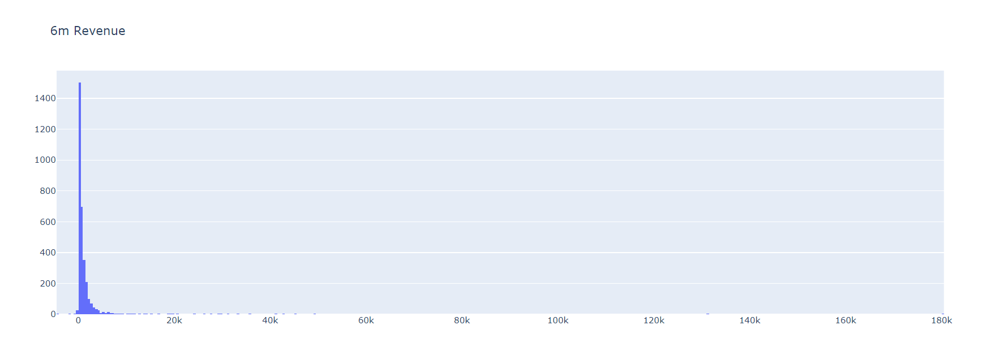

Slide 35
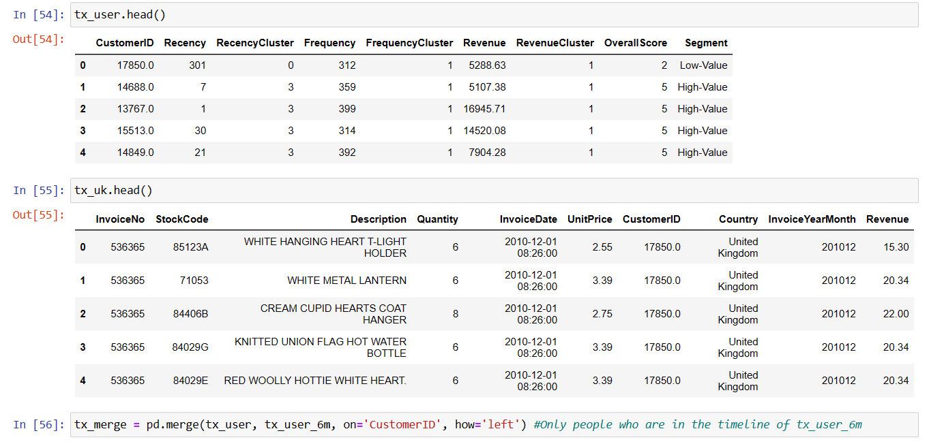

Slide 36
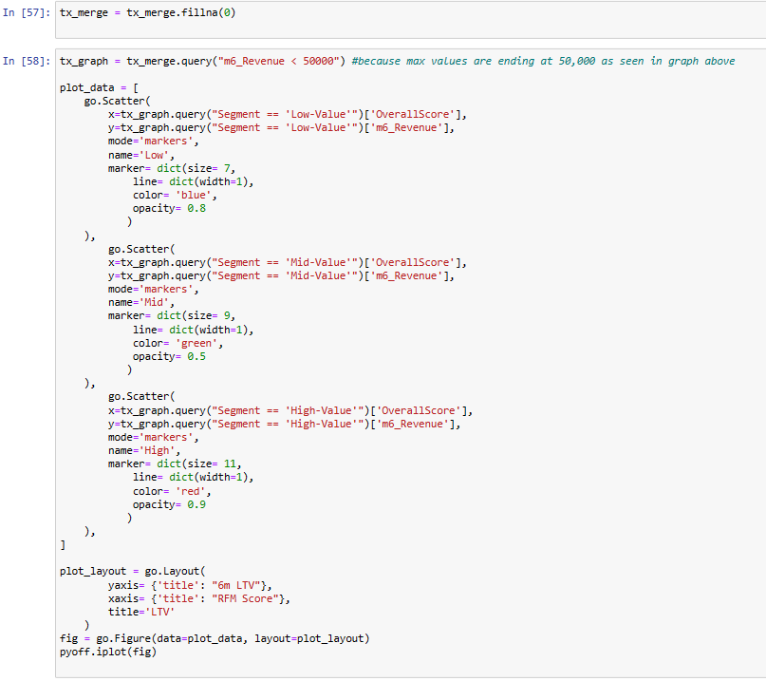

Slide 37
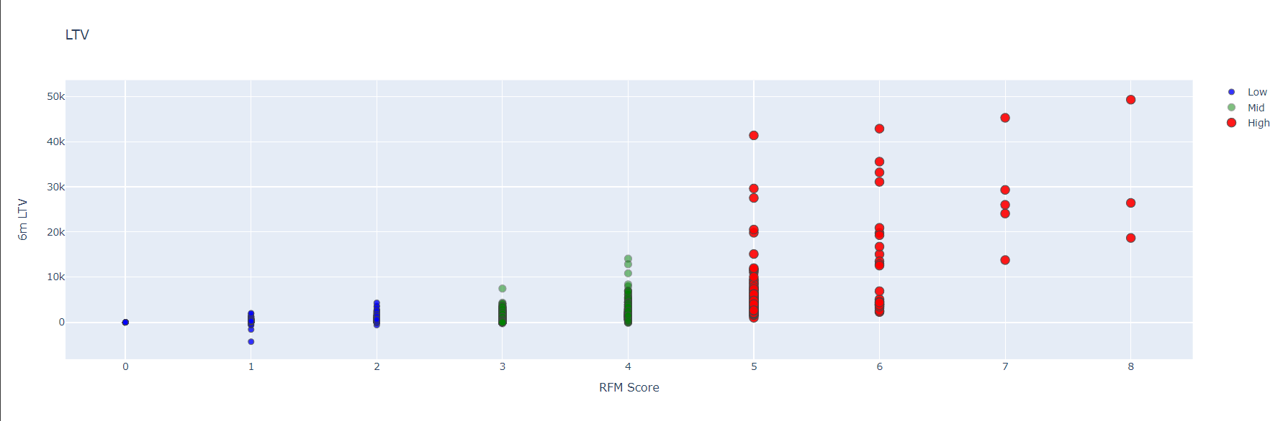

Slide 38
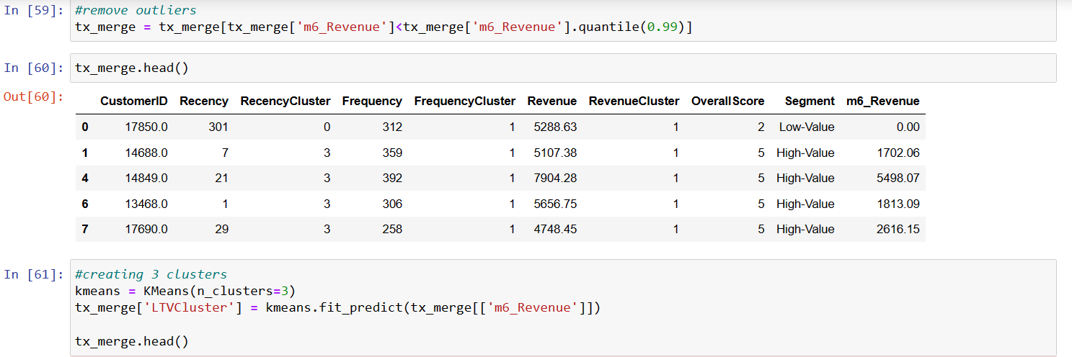

Slide 39
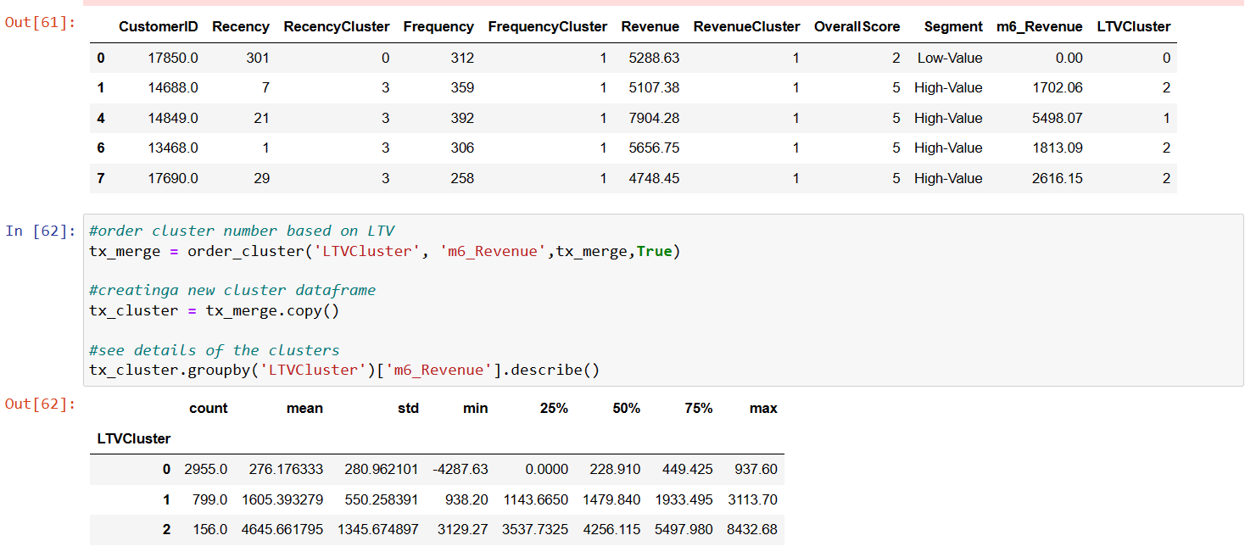

Slide 40
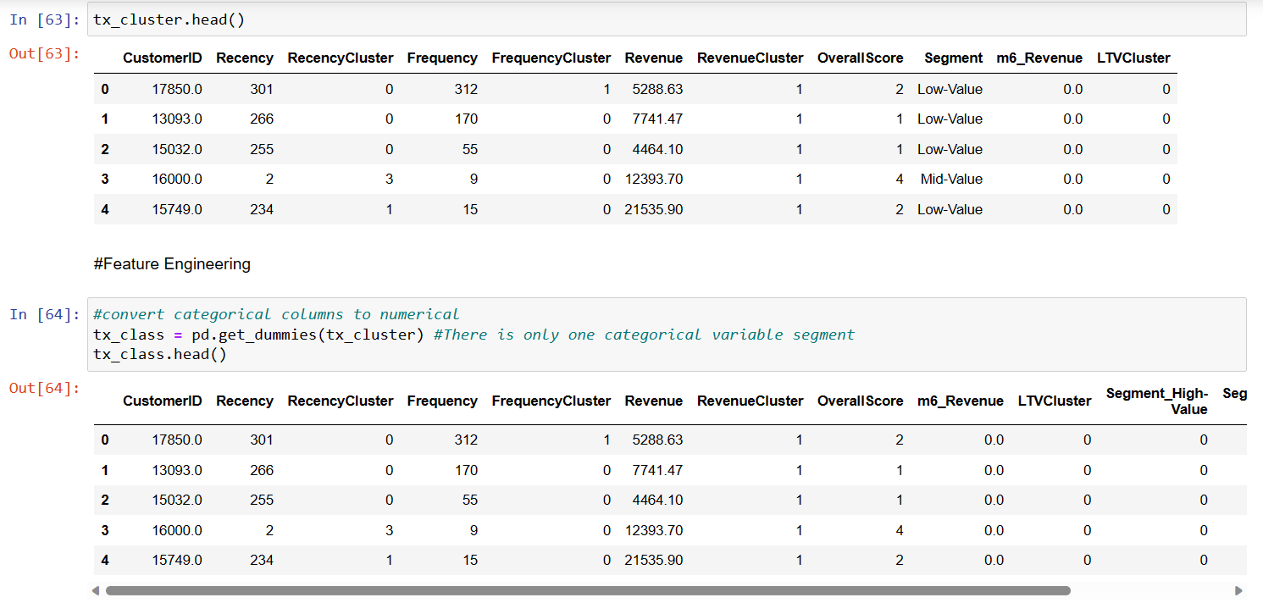

Slide 41
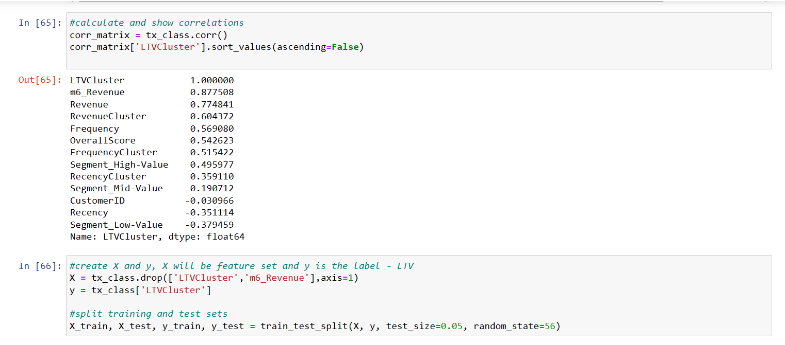

Slide 42
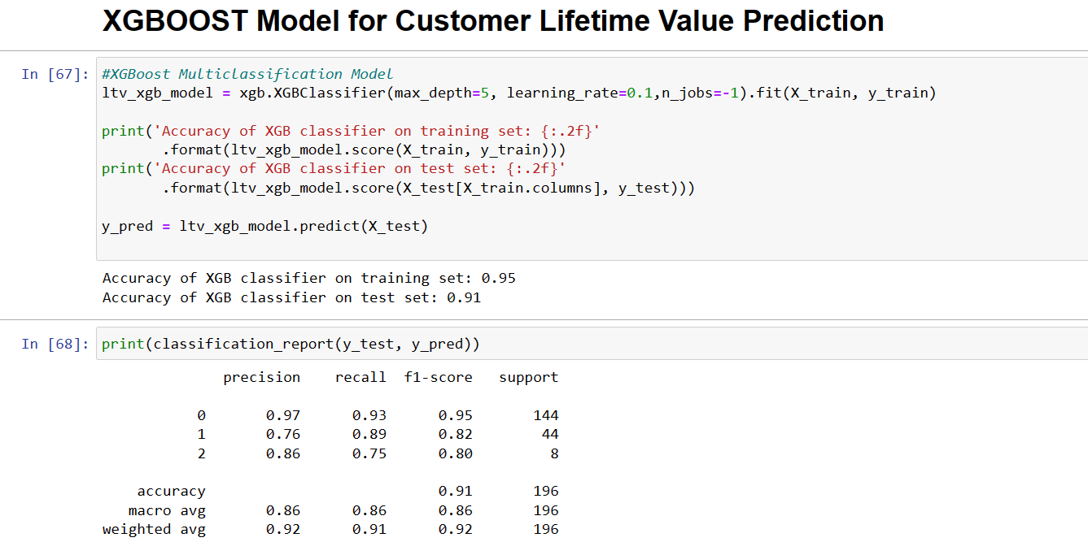

Slide 43
4
Conclusion

Slide 44
In conclusion, customer lifetime value analysis is a crucial tool for businesses looking to understand the long-term value of their customers and develop strategies to maximize their revenue and profitability. By calculating customer lifetime value, businesses can identify their most valuable customers, develop personalized marketing strategies to retain them, and optimize their acquisition and retention efforts to drive growth and increase profitability. Through the use of advanced data analysis and machine learning techniques, businesses can gain deeper insights into customer behavior and preferences, allowing them to tailor their marketing efforts and provide a more personalized customer experience. Ultimately, customer lifetime value analysis is a powerful tool for businesses looking to stay competitive and succeed in today's data-driven marketplace.

Slide 45
5
Application Areas

Slide 46
Aviation industry:
CLV is used in the aviation industry to understand the profitability of each customer and assess their creditworthiness.
E-commerce:
E-commerce businesses use CLV to optimize their customer acquisition strategies and allocate resources more effectively.
By understanding the lifetime value of their customers, e-commerce companies can focus on acquiring high-value customers and retaining them over the long term.

Slide 47
Thank You

